Slide 1
Mass Encoding
Shalmon Anandas [92]
M.Sc Part II
Department of Bioinformatics

Slide 2
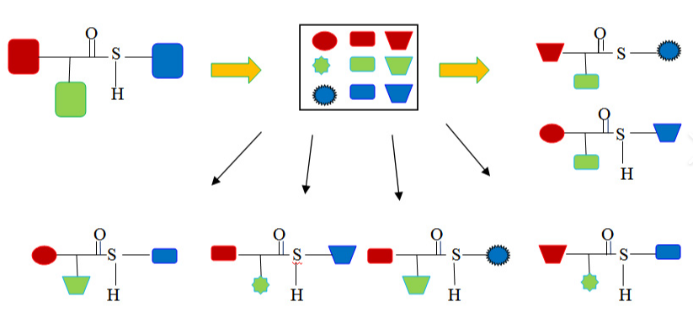
Combinatorial Chemistry

Slide 3
What is combinatorial chemistry
Large Pool
Pool 1
Pool 1
Active compound
Pool 2
Active compound
Pool 2
Pool 4
Active compound
Pool 3
Active compound
1
2
3
1
2
3
1
2
3
code
code
4
4
5
6
4
5
6
5
6
7
8
7
8
9
code
7
8
9
9
Assay
Compounds separated from beads
Beads

Slide 4
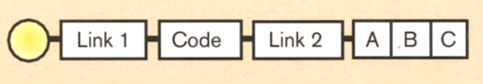
Single peak positional encoding

Slide 5
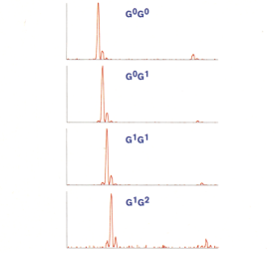
Single peak positional encoding

Slide 6
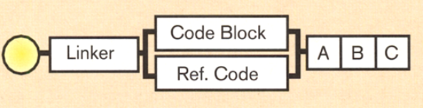
Double peak positional encoding

Slide 7
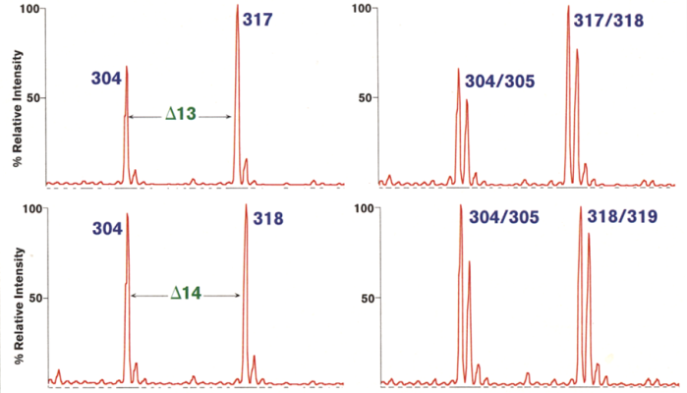
Double peak positional encoding

Slide 8
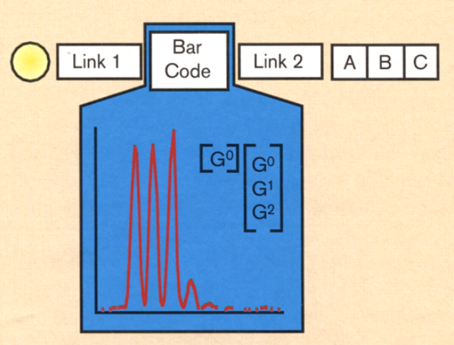
Bar code encoding

Slide 9
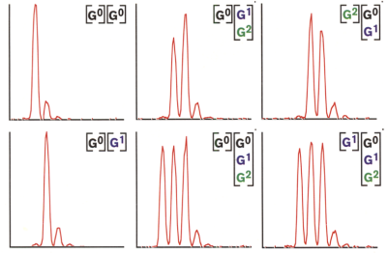
Bar code encoding

Slide 10
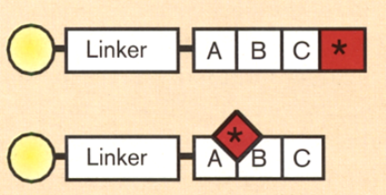
Ratio encoding

Slide 11
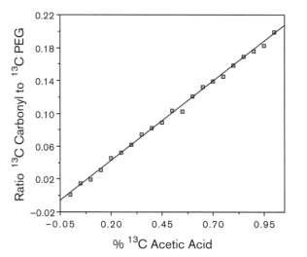
Ratio encoding

Slide 12
Thank you

